Slide 1
LECTURE ID :18B11CS311STL02 PROGRAMME : B.Tech. COURSE TITLE : Computer Networks and Internet of Things LECTURE TITLE : Routing Principle (Part I) FACULTY NAME : Dr. Shobhit Tyagi

Slide 2
Routing Principle (Part I)
By Dr. Shobhit Tyagi Dept. of CSE & IT JIIT, NOIDA

Slide 3
Topics of Today’s Lecture
Network Layer Service
Datagram and VC Services
IP Datagram Format
Datagram Encapsulation and Fragmentation

Slide 4
Network Layer Service
The Network layer is the third layer in the OSI model of computer networks. Its main function is to transfer network packets from the source to the destination.

Slide 5
Network Layer Service
It is involved both at the source and the destination. At the source, it accepts a packet from the Transport layer, encapsulates it in a datagram, and then delivers the packet to the Data link layer for further transmission to the receiver.
At the destination, the datagram is decapsulated, the packet is extracted, and it is delivered to the corresponding Transport layer.

Slide 6
Network Layer Service
The services which are offered by the network layer protocol are as follows –
Packetizing:
Packetizing is the process of encapsulating data received from upper layers (also known as the payload) into a Network layer packet at the source and decapsulating the payload from the Network layer packet at the destination.

Slide 7
Network Layer Service
At the source, the Network layer adds a header containing the source and destination addresses, along with other relevant information required by the Network layer protocol.
This packet is then delivered to the Data Link layer for further transmission.

Slide 8
Network Layer Service
Routing and Forwarding:
These are two additional services provided by the Network layer. In a network, multiple routes may be available from the source to the destination.
The Network layer employs various strategies to determine the best possible route.

Slide 9
Network Layer Service
Routing and Forwarding:
This process is known as routing. Several routing protocols facilitate this process, helping routers coordinate with each other and establish communication throughout the network.

Slide 10
Network Layer Service
Routing and Forwarding:
Forwarding is defined as the action taken by each router when a packet arrives at one of its interfaces.
When a router receives a packet from one of its attached networks, it must forward the packet to another attached network (in the case of unicast routing) or to multiple attached networks (in the case of multicast routing).

Slide 11
Network Layer Service
Advantages of Network Layer Services:
The packetization service in the Network layer facilitates the efficient transportation of data packets.
Packetization helps eliminate single points of failure in data communication systems.

Slide 12
Network Layer Service
Advantages of Network Layer Services:
Routers in the Network layer reduce network traffic by creating separate collision and broadcast domains.
Through forwarding, data packets are effectively transferred from one location to another within the network.

Slide 13
Datagram and VC Services
Both Virtual Circuits and Datagram Networks are types of connection services used for transmitting information from a sender to a receiver.

Slide 14
Datagram and VC Services
The primary difference between the two is that Virtual Circuits are connection-oriented services requiring resources such as buffers, CPU, and bandwidth for a data transfer session.
In contrast, Datagram Networks are connectionless services that do not require such resources for data transmission.

Slide 15
Datagram and VC Services
What are Virtual Circuits?
A Virtual Circuit is a connection-oriented service where resources such as buffers, CPU time, and bandwidth are allocated to create a dedicated data transfer session.
This type of service is also known as connection-oriented switching.

Slide 16
Datagram and VC Services
What are Virtual Circuits?
In a virtual circuit, the path taken by the first data packet is established and fixed, so all subsequent packets follow the same path and use the same resources.
As a result, all packets in the same session use a consistent header.

Slide 17
Datagram and VC Services
What are Virtual Circuits?
Due to these characteristics, virtual circuits are generally less complex and more reliable for data transmission.
However, they can be expensive to install and maintain. Virtual circuits are commonly used in Asynchronous Transfer Mode (ATM) networks, which are often employed for telephone calls.

Slide 18
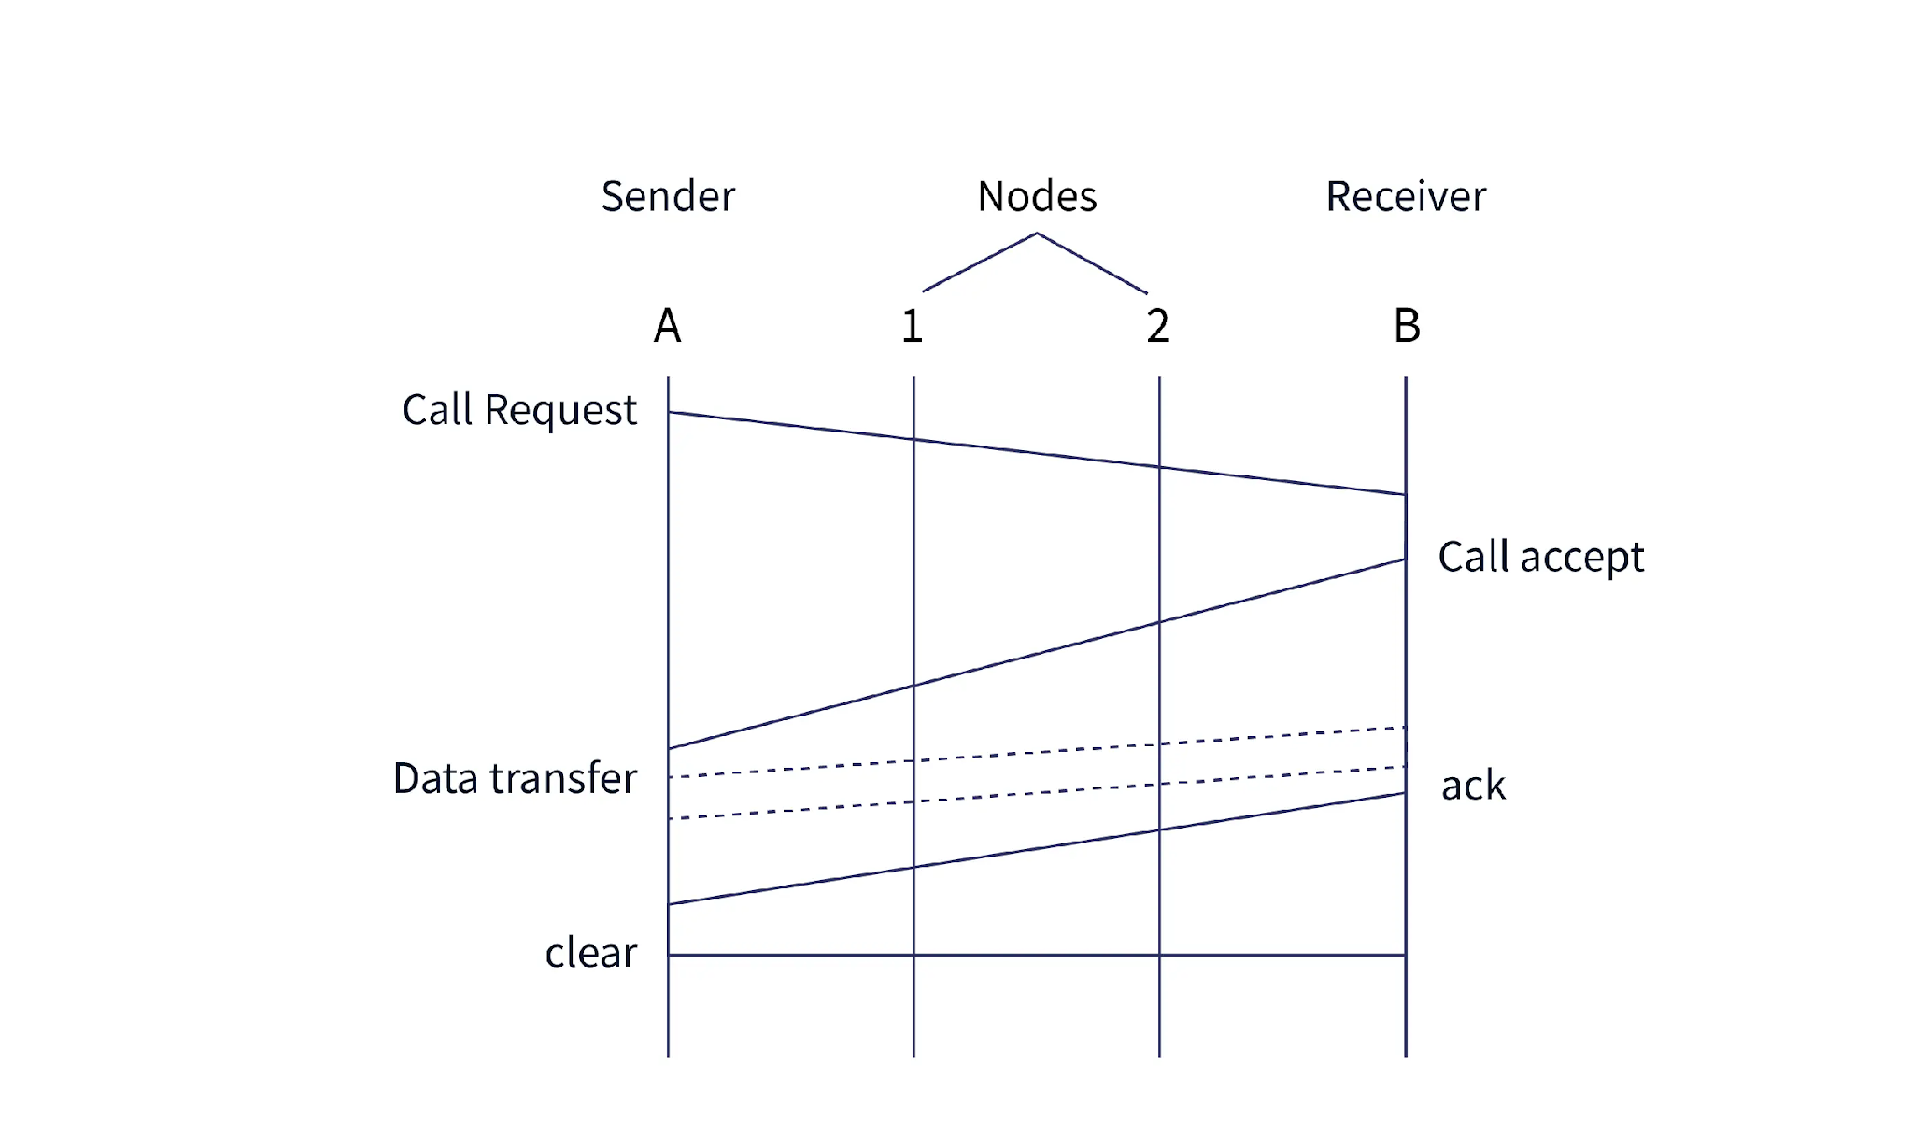
Datagram and VC Services
What are Virtual Circuits?
Sender
Nodes
Receiver
A
1
2
B
Call Request
Call Accept
Data Transfer
ack
Clear

Slide 19
Datagram and VC Services
What are Datagram Networks?
Datagram networks are connectionless services for data transmission, where resources such as CPU time, buffers, and bandwidth are not reserved in advance.

Slide 20
Datagram and VC Services
What are Datagram Networks?
In datagram networks, the path for data transmission is not predetermined. Instead, data packets can take different routes to their destination, which each packet potentially following a different path based on the current state of the routing tables in intermediate routers.
This dynamic routing allows packets to be directed independently through the network.

Slide 21
Datagram and VC Services
What are Datagram Networks?
Since data packets can follow different paths, each packet may have a distinct header with information specific to that packet.

Slide 22
Datagram and VC Services
What are Datagram Networks?
Due to dynamic resource allocation and variable routing paths, datagram networks are more prone to errors and less reliable compared to connection-oriented networks.
However, datagram networks are cheaper to install and maintain. They are widely used in IP (Internet Protocol) services, such as the internet.

Slide 23

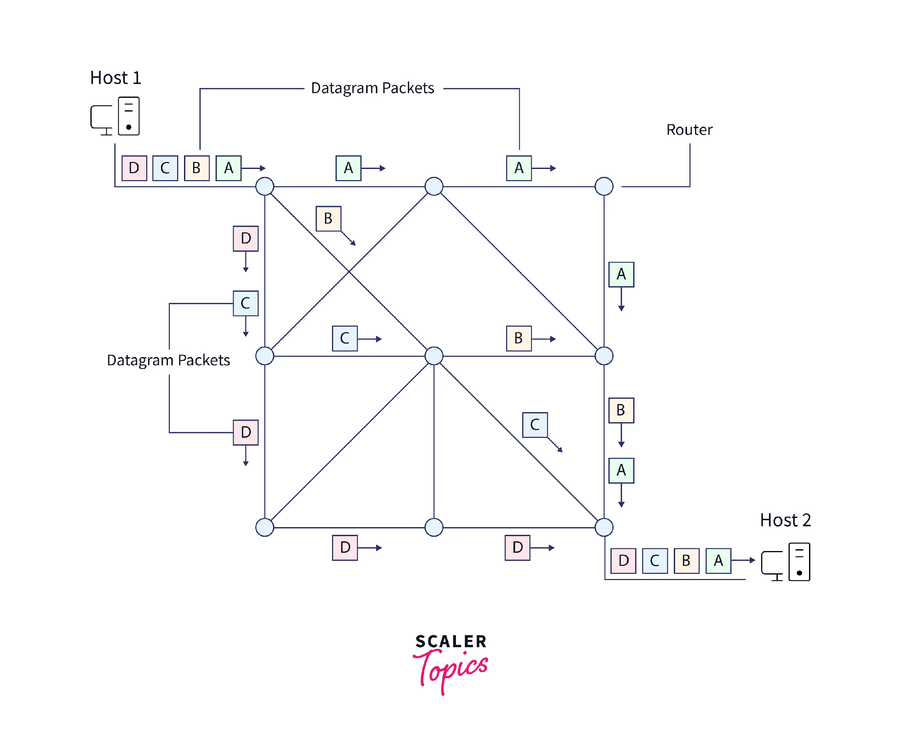
Datagram and VC Services
What are Datagram Networks?
Datagram Packets
Host 1
Router
D
C
B
A
A
A
B
D
A
C
C
B
Datagram
Packets
B
C
D
A
Host 2
D
D
D
C
B
A

Slide 24
IP Datagram Format
Format of an IP Datagram:
An IP datagram is the format of data that can be recognized and processed by the IP protocol. It consists of two components; the header and the data.
The fields within the datagram, excluding the data itself, each have specific roles in the data transmission process.

Slide 25
IP Datagram Format
Format of an IP Datagram:
Every field in the IP datagram has a fixed size, except for the IP Options field, which can range from 20 to 60 bytes in length.
The header is used by the sending computer to communicate with the protocol at the same layer on the destination computer.

Slide 26
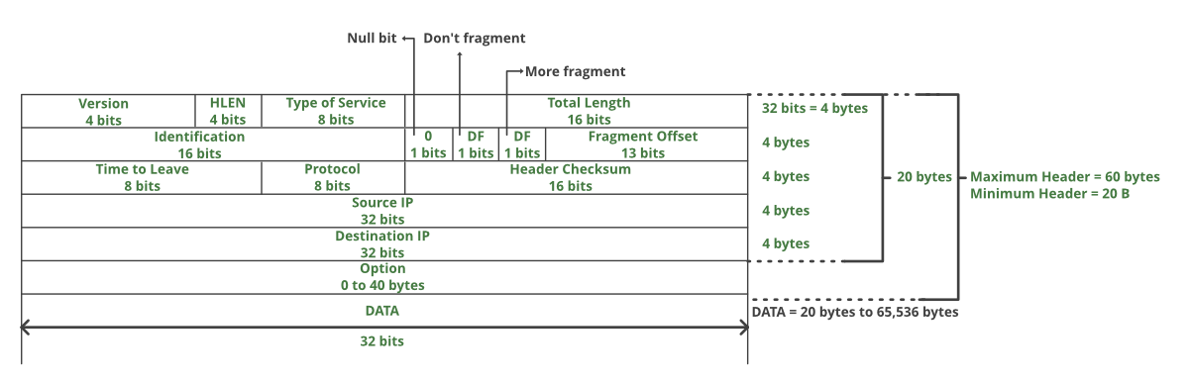
IP Datagram Format
Format of an IP Datagram
Don't fragment
Reserve bit
More fragment
Version 4 bits
HLEN 4 bits
Type of
Service 8 bits
Total Length 16 bits
4 bytes
R
1 bits
DF
1 bits
MF
1 bits
Fragment Offset
13 bits
4 bytes
Maximum
Header = 60 Bytes
Minimum
Header = 20 Bytes
Identification 16 bits
20 bytes
Time to Leave 8 bits
Protocol 8 bits
Header Checksum 16 bits
4 bytes
Source IP (32 bits)
4 bytes
Destination IP (32 bits)
4 bytes
Options & Padding (0 to 40 bytes)
DATA
DATA
(20 bytes to 65,536 bytes)
32 bits

Slide 27
IP Datagram Format
VERSION: Version of the IP protocol (4 bits), which is 4 for IPv4.
HLEN: IP header length (4 bits), indicating the number of 32-bit words in the header. The minimum value for this field is 5 and the maximum is 15.

Slide 28
IP Datagram Format
Type of Service: Specifies Low Delay, High Throughput, and Reliability (8 bits).
Total Length: Length of the header plus data (16 bits). The minimum value is 20 bytes, and the maximum is 65,535 bytes.

Slide 29
IP Datagram Format
Identification: Unique packet ID for identifying the fragments of a single IP datagram (16 bits).
Flags: Three 1-bit flags:
Reserved bit (must be zero),
Do not fragment flag (1 bit), and
More fragments flag (1 bit) (to indicate if there are more fragments)

Slide 30
IP Datagram Format
Fragment Offset: Represents the number of data bytes ahead of a particular fragment within the datagram.
It is specified in units of 8 bytes, with a maximum value of 65,528 bytes.

Slide 31
IP Datagram Format
Time to Live (TTL): Indicates the datagram’s lifetime (8 bits). It prevents the datagram from looping indefinitely through the network by limiting the number of hops (i.e., the number of routers it can pass through) before being delivered to the destination. Range : 0-255.
Protocol: Specifies the protocol to which the data should be passed (8 bits).
Header Checksum: A 16-bit checksum used to detect errors in the datagram header.

Slide 32
IP Datagram Format
Source IP Address: The 32-bit IP address of the sender.
Destination IP Address: The 32-bit IP address of the receiver.
Options: Optional fields that may include information such as source route, record route, and Padding. These are used by network administrators for various purposes, such as checking whether a path is functioning correctly.

Slide 33
IP Datagram Format
Options: Optional fields that may include information such as:
Record route
Source route
Strict Source Routing
Loose Source Routing
Padding
These are used by network administrators for various purposes, such as checking whether a path is functioning correctly.

Slide 34
Datagram Encapsulation and Fragmentation
Data Encapsulation :
Encapsulation is the process of adding additional information to data as it travels through the OSI or TCP/ IP model.
This additional information is added on the sender’s side, starting from the Application layer and progressing down to the Physical layer.

Slide 35
Problem
A datagram of 2000B (20B of IP header + 1980B IP Payload) reached at the router and must be forwarded to link with MTU of 500B. How many fragments will be generated and also write MF, Offset, total length value for all.

Slide 36
Datagram Encapsulation and Fragmentation
Working of Encapsulation :
No additional information is added to the user’s data in the Application layer of the TCP/ IP model or in the Application, Presentation, Session layers of the OSI model.
The Session layer then passes the data to the Transport layer.

Slide 37
Datagram Encapsulation and Fragmentation
Working of Encapsulation :
In the Transport layer, the data is divided into smaller pieces.
Each piece is encapsulated with a header containing information such as source port, destination port, sequence number, etc.
The result is a new form of data that combines the original data with the headers.

Slide 38
Datagram Encapsulation and Fragmentation
Working of Encapsulation :
The encapsulated data in the Transport layer is referred to as Segments or Datagrams.
If TCP is used for transmission, it is called Segments; if UDP is used, it is called Datagrams.

Slide 39

Datagram Encapsulation and Fragmentation
L4 Header
Data
Now, the data travels down to the Network layer, where a Layer 3 header is added. This header contains information such as source IP address, destination IP address, and other relevant details. The result is a new form of encapsulated data. At this stage, the encapsulated data in the Network layer is referred to as Packets

Slide 40

Datagram Encapsulation and Fragmentation
L3 Header
L4 Header
Data
The network layer then sends the packet to the Data Link layer. Upon entering the Data Link layer, a new header (Layer 2) is added, along with a trailer. The header includes information such as the source and destination MAC addresses, while the trailer is used for error checking. The encapsulated data in the Data Link layer is referred to as Frames.

Slide 41

Datagram Encapsulation and Fragmentation
L2 Header
L3 Header
L4 Header
Data
L2 Trailer
The physical layer receives frames from the Data Link layer. At this stage, the data is encapsulated into a format called Bits. This process illustrates how encapsulation occurs throughout the layers of the OSI or TCP/ IP models.

Slide 42
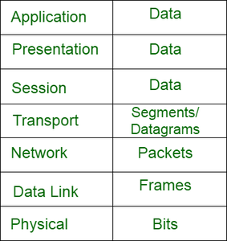
Datagram Encapsulation and Fragmentation
Protocol Data Unit (PDU) :
The encapsulated data is referred to by different names as it moves through each layer of the OSI or TCP/IP model.
These names are collectively known as Protocol Data Units (PDUs). The following table shows the name of the encapsulated data at each layer.
Application
Data
Presentation
Data
Session
Data
Transport
Segments/
Datagrams
Network
Packets
Data Link
Frames
Physical
Bits

Slide 43
Datagram Encapsulation and Fragmentation
De-encapsulation :
De-encapsulation is the reverse process of encapsulation.
The additional information added on the sender’s side (during encapsulation) is removed as the data travels from the Physical layer to the Application layer on the receiver’s side.

Slide 44

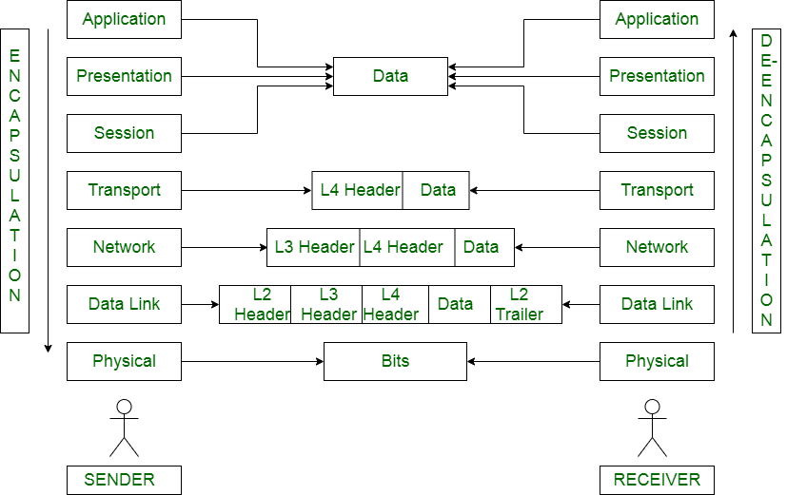
Datagram Encapsulation and Fragmentation
Application
Application
Presentation
Data
Presentation
Session
Session
Transport
L4 Header Data
Transport
De-encapsulation
Encapsulation
Network
L3 Header L4 Header Data
Network
Data Link
L2 Header
L3 Header
L4 Header
Data
L2 Trailer
Data Link
Physical
Bits
Physical
SENDER
Receiver

Slide 45
Datagram Encapsulation and Fragmentation
Fragmentation:
Fragmentation occurs at the Network layer when the size of datagram exceeds the maximum size that can be accommodated by a frame, known as the Maximum Transmission Unit (MTU).
To ensure data flow is not disrupted, the Network layer divides the datagram received from the Transport layer into smaller fragments.

Slide 46
Datagram Encapsulation and Fragmentation
Fragmentation:
Since the IP header has a 16-bit field for total length, the maximum size of an IP datagram = 2¹⁶ – 1 = 65, 535 bytes.
Fragmentation is performed by the Network layer and typically occurs at routers along the path to the destination.

Slide 47
Datagram Encapsulation and Fragmentation
IP Fragmentation:
IP Fragmentation is the process of dividing a datagram into smaller fragments during transmission.
This process is performed by intermediary devices, such as routers, or by the destination host at the Network layer.

Slide 48
Datagram Encapsulation and Fragmentation
Need for IP Fragmentation:
Each network has a Maximum Transmission Unit (MTU), which dictates the maximum size of the packet that can be transmitted through it.
Data packets larger than MTU cannot be transmitted through the network.

Slide 49
Datagram Encapsulation and Fragmentation
Need for IP Fragmentation:
Therefore, datagrams are divided into fragments that are smaller than or equal to the MTU.
This ensures that data packets can be transmitted efficiently across networks with varying MTU sizes.

Slide 50
Datagram Encapsulation and Fragmentation
Datagram Fragmentation:
When a router receives a datagram for further transmission, it examines the following:
The size of the datagram.
The MTU of the destination network.
The value of the DF (Don’t Fragment) bit in the IP header.

Slide 51
Datagram Encapsulation and Fragmentation
Then, the following cases are possible:
Case 1:
If the size of the datagram is smaller than or equal to the MTU
The router transmits the datagram without fragmentation.
Case 2:
If the size of the datagram is greater than the MTU and the DF (Don’t Fragment) bit is set to 1
The router discards the datagram.

Slide 52
Datagram Encapsulation and Fragmentation
Case 3:
If the size of the datagram is greater than the MTU and the DF (Don’t Fragment) bit is set to 0.
The router divides the datagram into fragments of size less than or equal to the MTU.
The router attaches an IP header to each fragment, making the necessary adjustments.
The router then transmits all the fragments of the datagram.

Slide 53
Datagram Encapsulation and Fragmentation
176 B
20 B
Received Datagram
(Second Fragment From Router -1)
88 B
20 B
88 B
20 B
2nd
1st
Fragments of Received Datagram

Slide 54
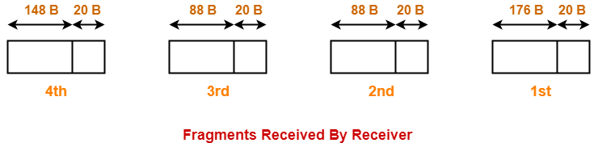
Datagram Encapsulation and Fragmentation
88 B
20 B
176 B
20 B
2nd
1st
148 B
20 B
88 B
20 B
4th
3rd
Fragments Received by Receiver

Slide 55
Thank You

